Slide 1







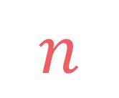

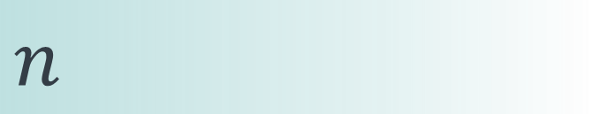

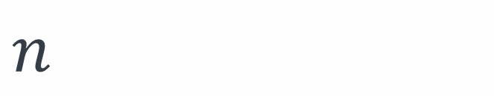
left
[4, 5, 1, 7, 2, 6, 3, 8]
no margin
Space complexity:
$$O(n)$$
list
list
list
list
mid
no margin
"string"
4 | 5 | 1 | 7 | 2 | 6 | 3 | 8
Space complexity:
$$O(n)$$
5
5
$
5
rec(n)
$$n$$
5
$$n$$
$$⇒$$
$$n$$
Time complexity:
$$O(n)$$
text
text
 |  |  | a
$$n$$
text
text
no margin
no margin
no margin
no margin
no margin
no margin
no margin
no margin

Slide 2
count
(2,'a')
count
(1,'a')
count
(0,'a')
count
(2,'e')
count
(1,'e')
count
(0,'e')
count
(3,'')
count
(2,'i')
count
(1,'i')
count
(0,'i')
count
(2,'o')
count
(1,'o')
count
(0,'o')
count
(2,'u')
count
(1,'u')
count
(0,'u')

Slide 3
count
(2,'a')
count
(1,'a')
count
(0,'a')
count
(2,'e')
count
(1,'e')
count
(0,'e')
count
(3,'')
count
(2,'i')
count
(1,'i')
count
(0,'i')
count
(2,'o')
count
(1,'o')
count
(0,'o')
count
(2,'u')
count
(1,'u')
count
(0,'u')

Slide 4
1
def count(n, last='', lookup=None): lookup = {} if lookup is None else lookup if (n, last) in lookup: return lookup[(n, last)] if n == 0: return 1 else: nb = 0 for vowel in ['a', 'e', 'i', 'o', 'u']: if last <= vowel: nb += count(n-1, vowel, lookup) lookup[(n, last)] = nb return lookup[(n, last)]
2
3
4

Slide 5




$$n∈\{n_{0},n_{0}−1,…,1\}$$
$$\text{last}∈\{"a", "e", "i", "o", "u"\}$$
$$n$$
$$5$$

Slide 6
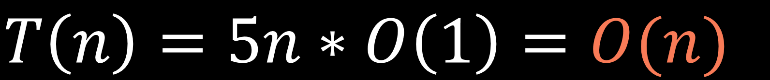
$$n∈\{n_{0},n_{0}−1,…,1\}$$
$$\text{last}∈\{"a", "e", "i", "o", "u"\}$$
$$n$$
$$5$$
$$T\left(n\right)=5n∗O\left(1\right)=O(n)$$

Slide 7
$$S\left(n\right)=O\left(n\right)+O\left(n\right)=O(n)$$
call stack size
lookup table size

